Slide 1






Financial Reporting
Financial Report Templates
Kim Dallefeld, MVP, MCT, MCP
#FinancialReportingHero

Slide 2

The BC 3 Amigos
https://www.youtube.com/@BC3Amigos

Slide 3
Session Overview
Build a template
Connect template to report definiction
Verify template updates
What’s next

Slide 4
What Can I Expect from this Session?
Learn how to build templates
Learn options

Slide 5
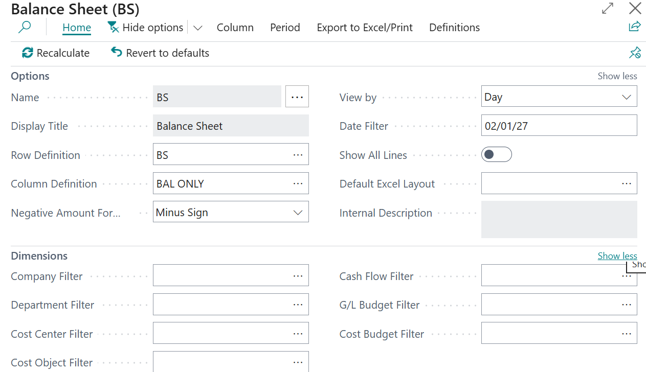
Financial Reporting List
Step 1 – Create new Excel Template
This takes data to Excel so that we can edit and add formatting.

Slide 6
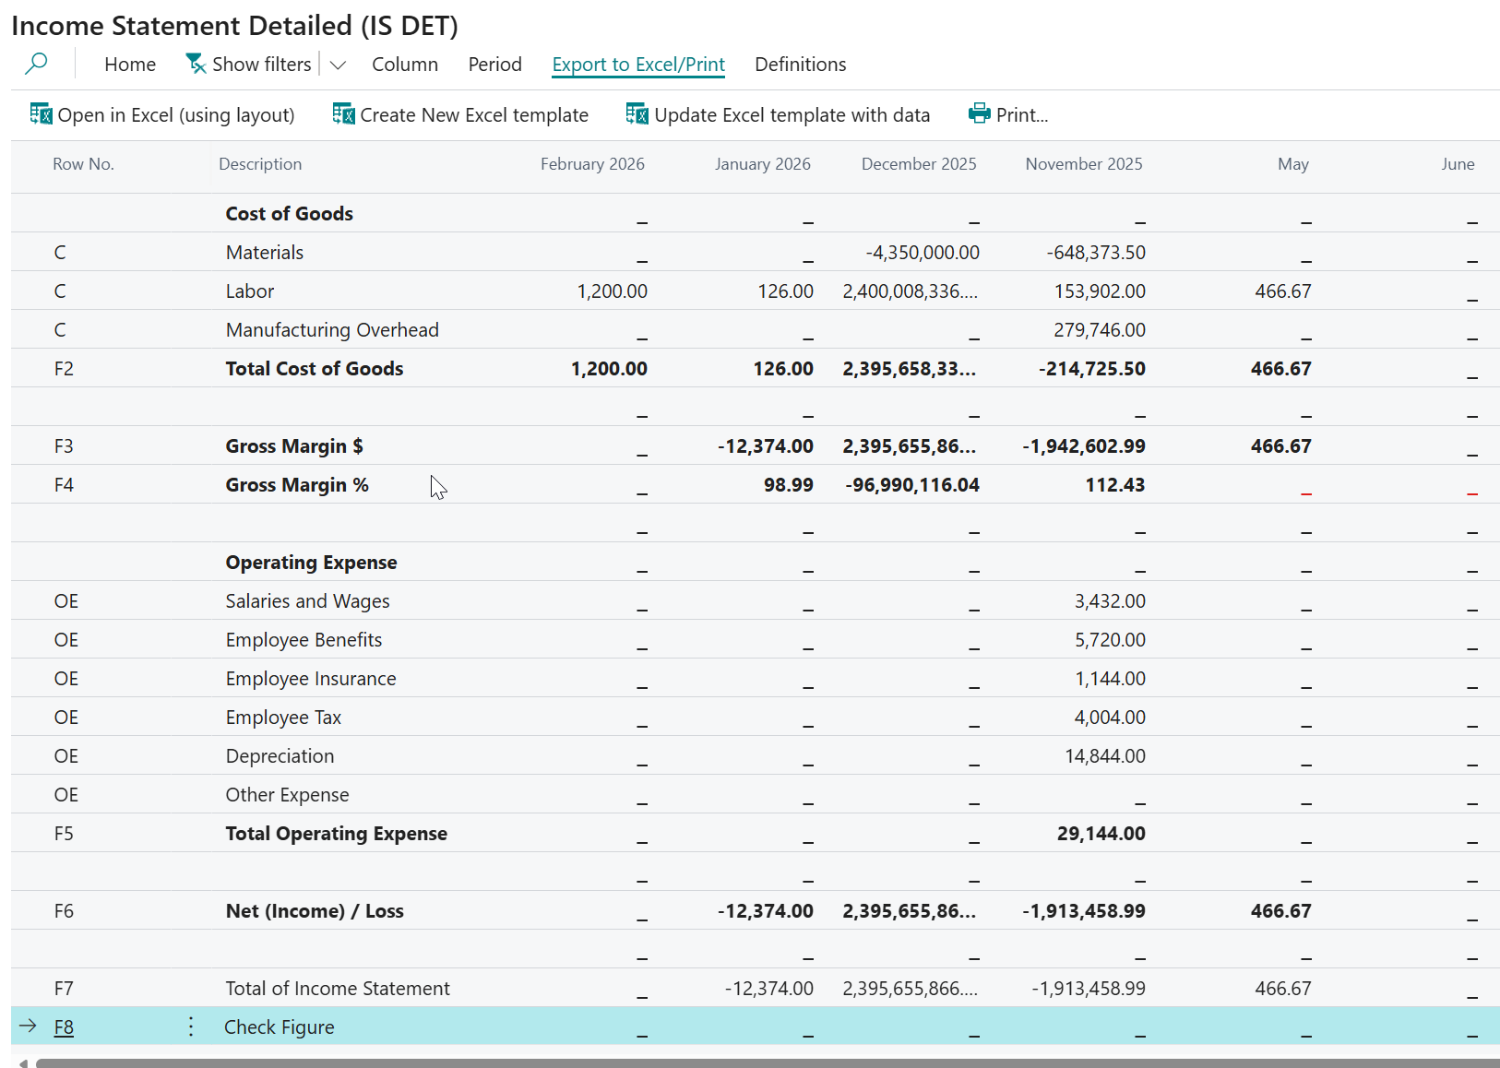
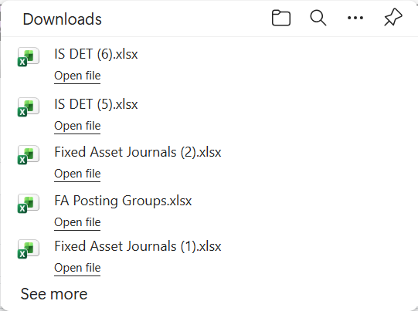
Financial Reporting List

Slide 7
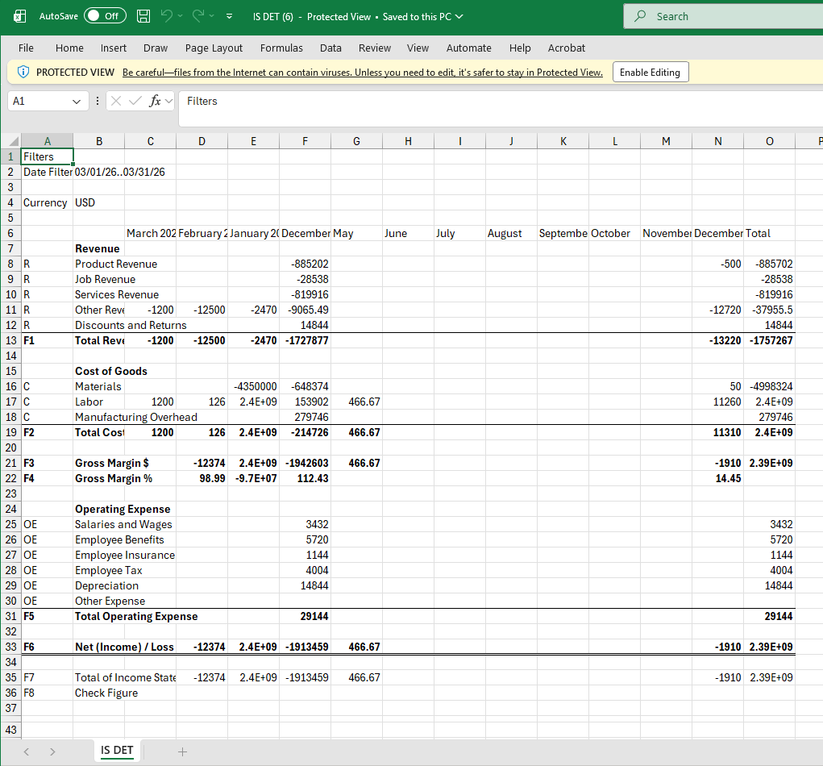
Once in Excel –
Enable Editing
Create a new tab
Name something more formal
Place cursor in Cell B6
  Hit ‘=‘
Move to Cell B6 on original tab
  Hit enter
  This places you back on new tab
Copy B6 to all rows and columns
  By dragging cursor

Slide 8
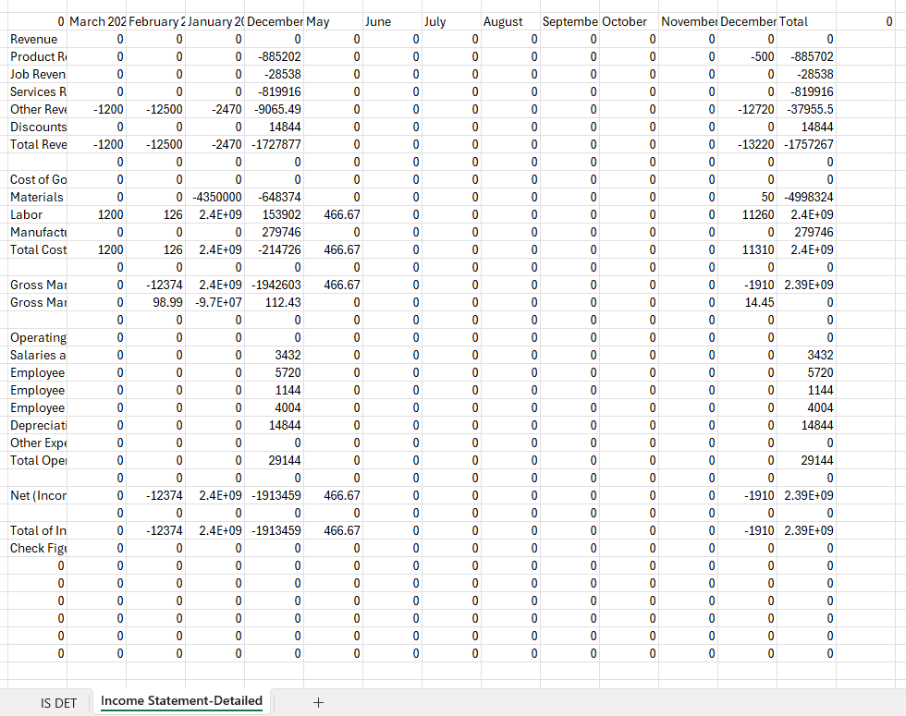
Only edit the new tab
Add bolding
Underlines
Clear zeros at headings and blank lines
Format amounts
Clear columns and rows at the bottom and right
Add Company Name and report name in the header
  Merge across all columns
  Format date in header from original tab filters
Hide original tab

Slide 9
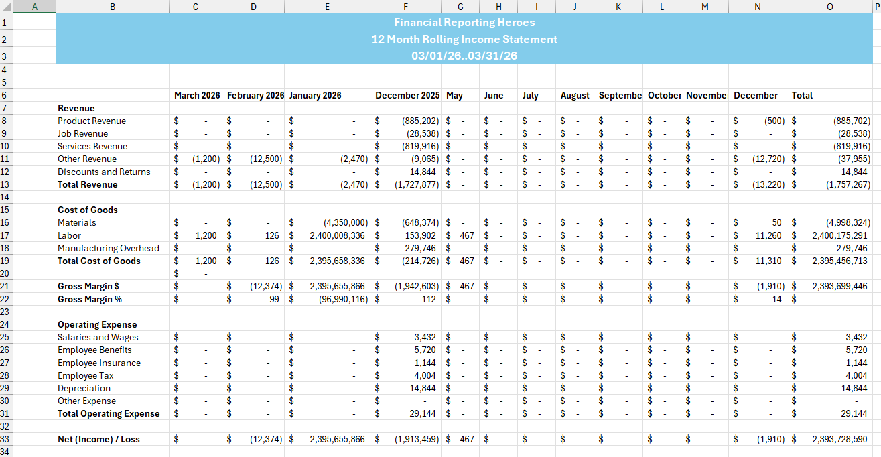

Slide 10
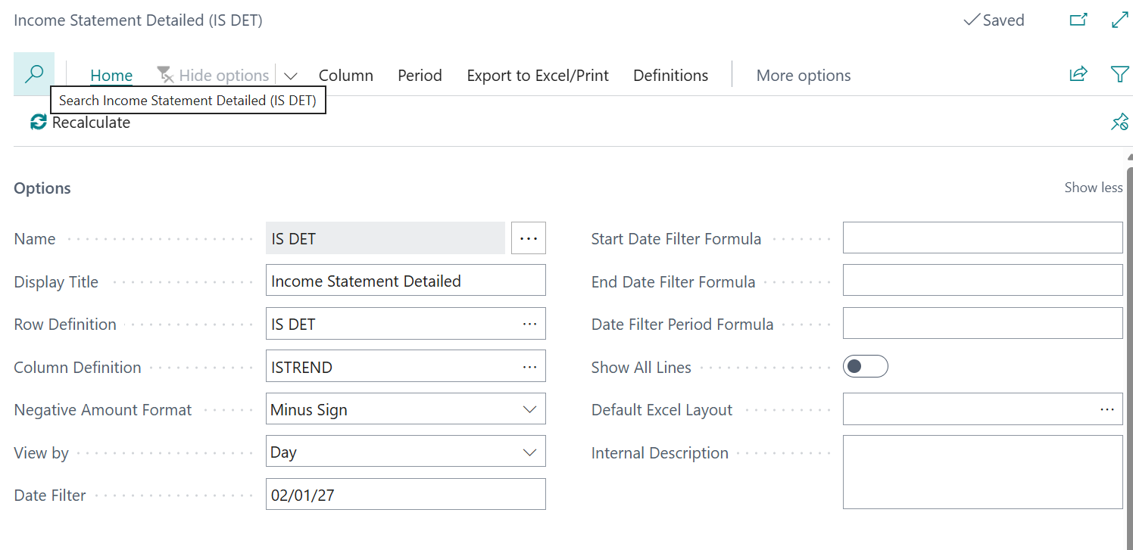
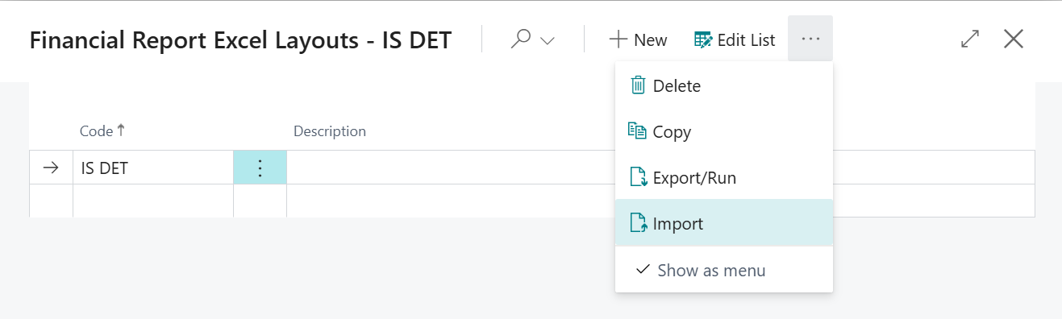
Financial Reporting List
Save in Business Central for Reuse each Month
First time, click new
Enter Code
Import the saved Excel file

Slide 11
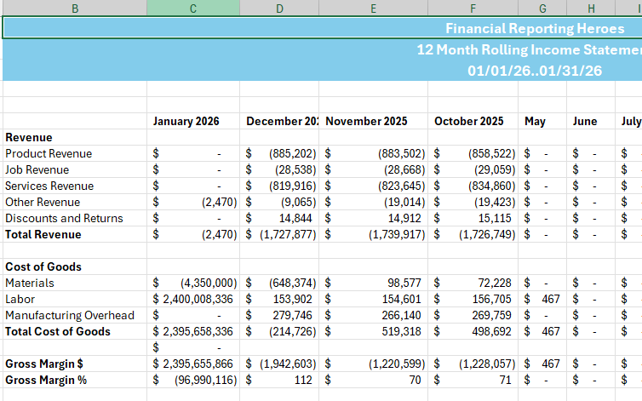
Financial Reporting
Verify your template works – run same report for different date range.
Use Open in Excel using layout
Open spreadsheet shown in Downloads
Make sure to Enable Editing – don’t panic that things are not displaying until you Enable Editing
Excerpt……….

Slide 12
Next Steps – More videos to come
Financial Report Template Building - Copilot
Financial Reports New Version 27 features

Slide 13

How Do I Watch the Episodes
https://www.youtube.com/@BC3Amigos
#FinancialReportingHero

