Slide 1






Financial Reporting
Financial Report Overview
Kim Dallefeld, MVP, MCT, MCP
#FinancialReportingHero

Slide 2

The BC 3 Amigos
https://www.youtube.com/@BC3Amigos

Slide 3
Session Overview
Review financial reporting list
Review how to view financial reports
Review options on the overview page
What’s next

Slide 4
What Can I Expect from this Session?
Learn how to view reports
Learn options when using report overview

Slide 5
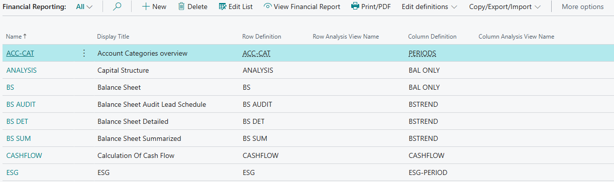
Financial Reporting List

Slide 6
Financial Reporting List
Important Options:
New – add new reports
Edit List – add internal descriptions, analysis views
View Financial Report – executes overview
Print/PDF – executes printed version
Edit definitions – quick access to definitions
Copy/Export/Format – great for moving to other companies

Slide 7
Financial Reporting
Viewing Financial Reports

Slide 8
Viewing Financial Reports
1
2
View Financial Report
Click on Report name

Slide 9
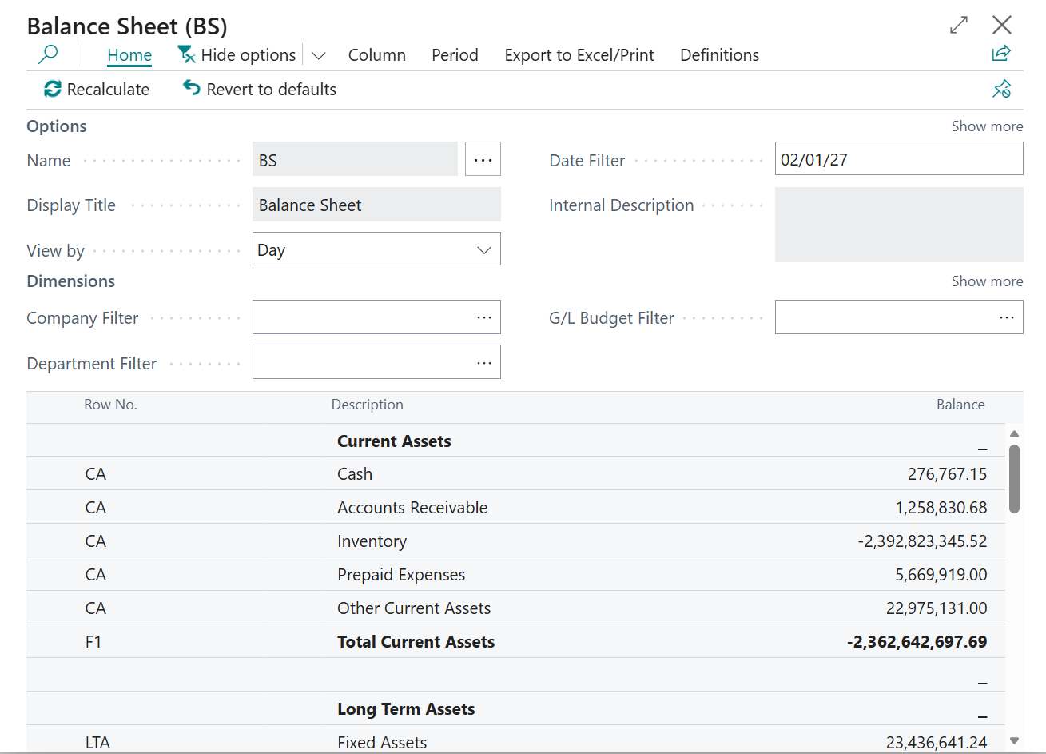
Viewing Financial Reports

Slide 10
Financial Reporting
Options in Overview

Slide 11
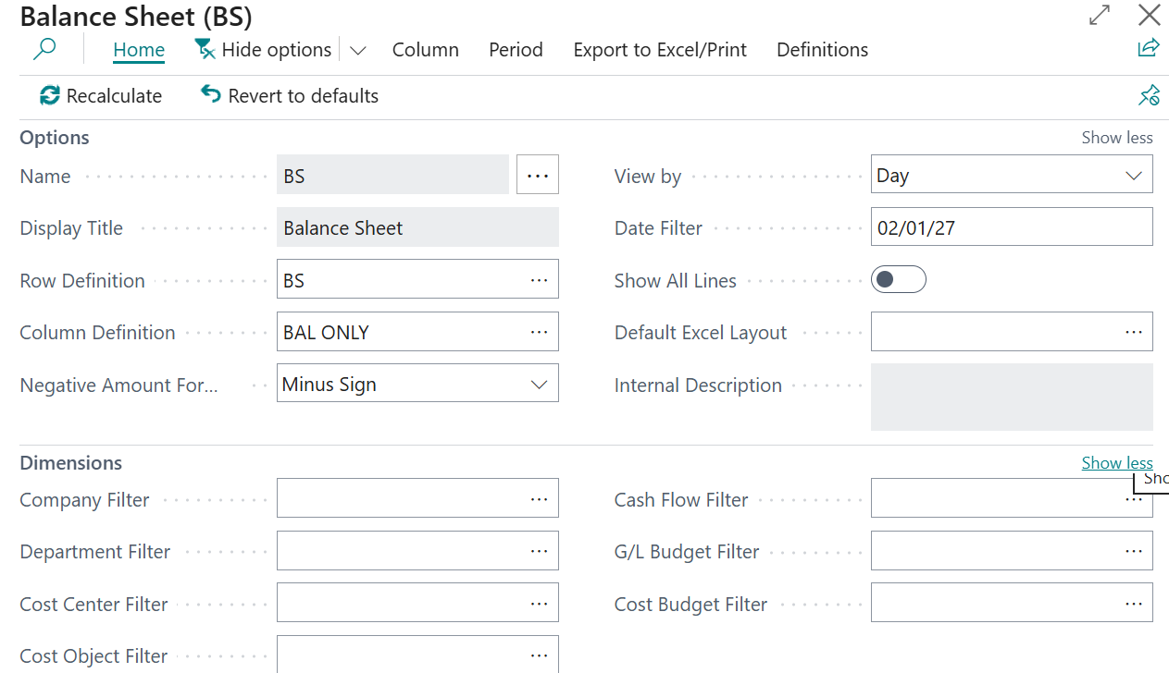
Viewing Financial Reports
Row and Column are last used!!!
View by and Date Filter Important!!
Filters not always needed
Hide Options - provides more real estate for viewing report

Slide 12
Viewing Financial Reports
Columns helpful to see more left to right!
Periods helpful for moving date forward and back!
Definitions easy access to row and column
Export to Excel/Print

Slide 13
Viewing Financial Reports

Slide 14
Next Steps – More videos to come
Financial Report Template Building
Financial Report Template Usage
Financial Reports New Version 27 features

Slide 15

How Do I Watch the Episodes
https://www.youtube.com/@BC3Amigos
#FinancialReportingHero

