Slide 1






Financial Reporting
Financial Reports V28
Kim Dallefeld, MVP, MCT, MCP
#FinancialReportingHero

Slide 2
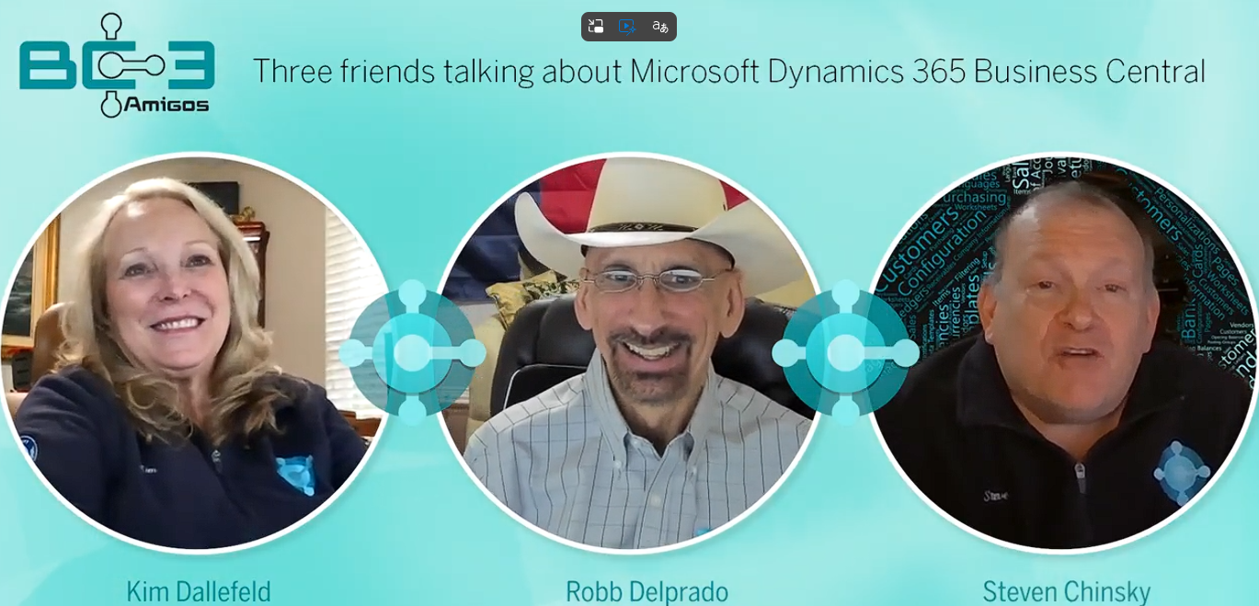
The BC 3 Amigos
https://www.youtube.com/@BC3Amigos

Slide 3
Session Overview
Review the new fields
Dimension perspectives
Demonstration
What’s next

Slide 4
What Can I Expect from this Session?
Learn about the new fields and features
Learn about new options

Slide 5
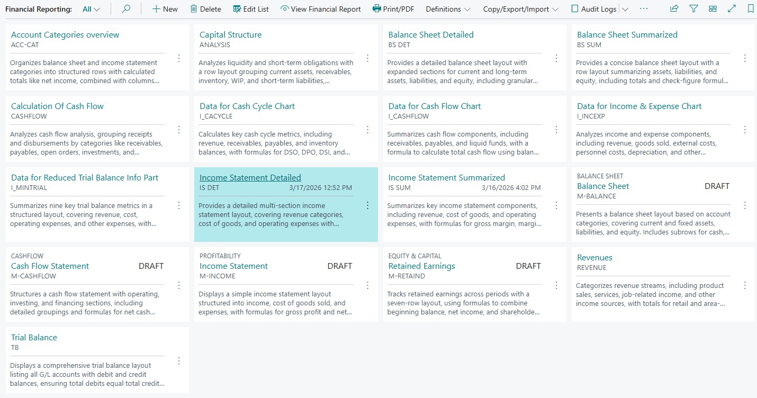
Financial Reporting in Business Central
Tile view of reports shows the ‘what’ is included with each definition!
Note: those that are in DRAFT status.

Slide 6
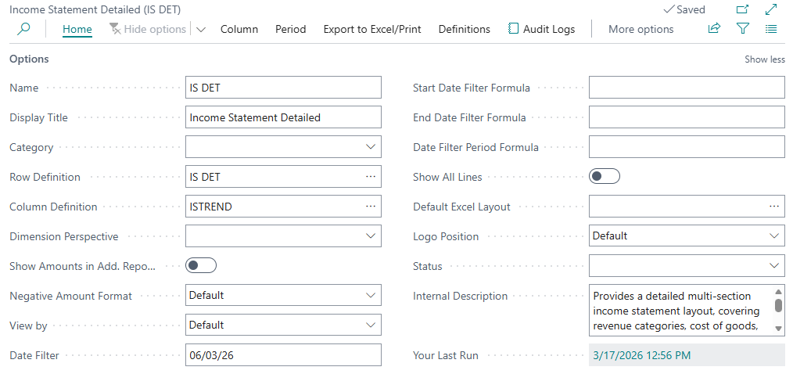
Financial Reporting in Business Central

Slide 7
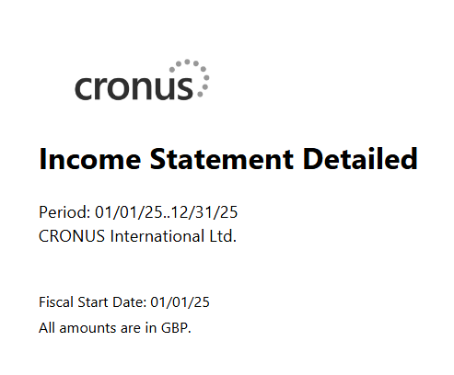
Financial Reporting in Business Central
Only for printed financial Report
But boy howdy that Logo is Fire! LOL

Slide 8
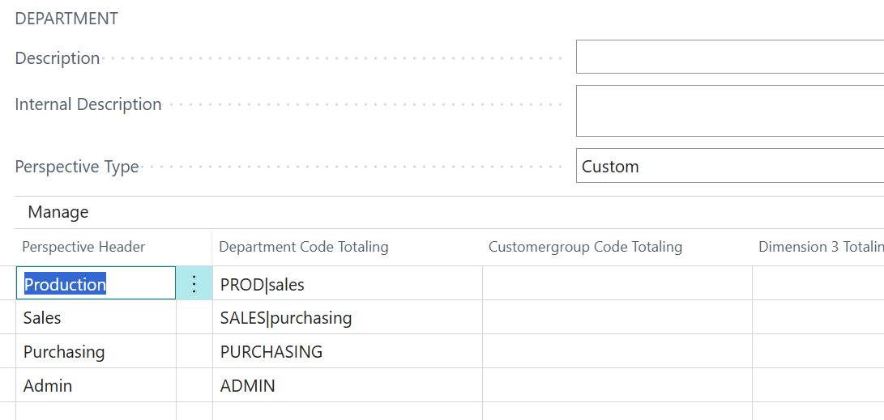
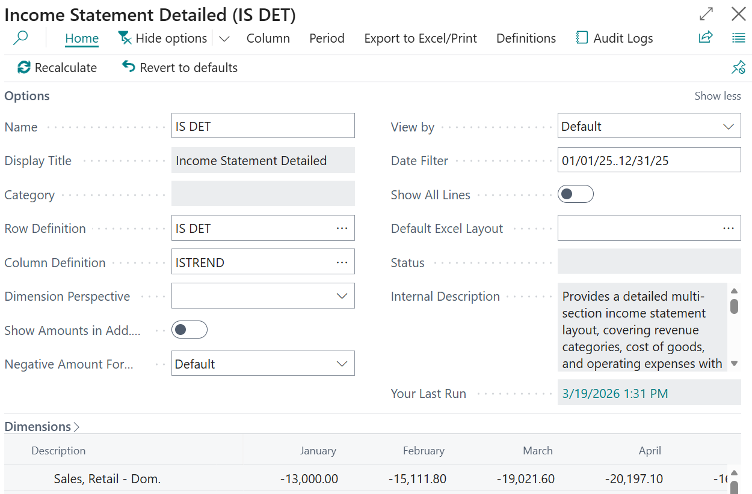
Financial Reporting – Dimension Perspectives

Slide 9
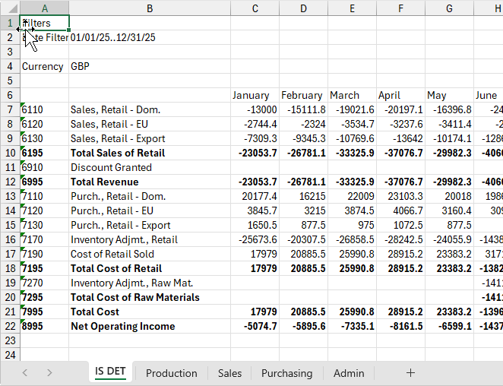
Financial Reporting in Business Central
NEW!!!

Slide 10
Next Steps – More videos to come
Watch for my next Copilot journey post
Go work with the steps in the video series
  Don’t forget to use the version 26 definitions – there great for ideas
  Try every option in row and column definitions - learn what they do
  When you hit a wall, phone a friend (Amigo)

Slide 11

How Do I Watch the Episodes
https://www.youtube.com/@BC3Amigos
#FinancialReportingHero

