Slide 1




Financial Reporting Using Dimensions / Analysis Views
Kim Dallefeld, MVP, MCT, MCP
#FinancialReportingHero

Slide 2

The BC 3 Amigos
https://www.youtube.com/@BC3Amigos

Slide 3
Session Overview
Review dimensions in row definitions
Review dimensions in column definitions
See dimension examples
What’s next

Slide 4
What Can I Expect from this Session?
Learn how to use dimensions in row definitions
Learn how to use dimensions in column definitions

Slide 5
Need to report dimensions on Financial Report
Dimensions to be used on the Report are not just the two (2) Global Dimensions
Report needs dimensions other than two Globals
Financial Reports allow for two Global and two other dimensions
Financial Report Analysis Views

Slide 6
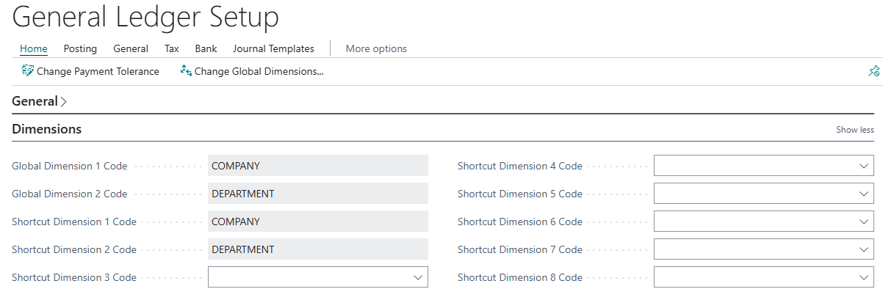
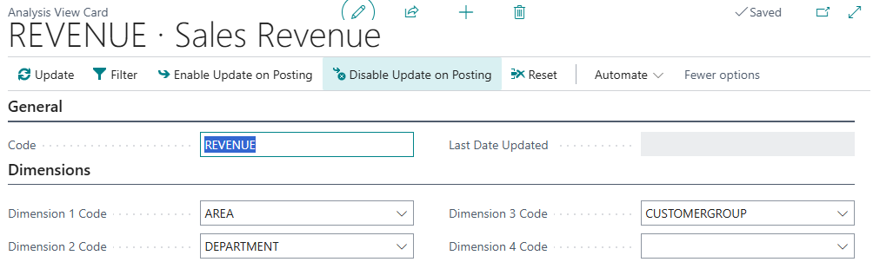

Slide 7
Financial Reporting Dimensions in Row Definitions

Slide 8
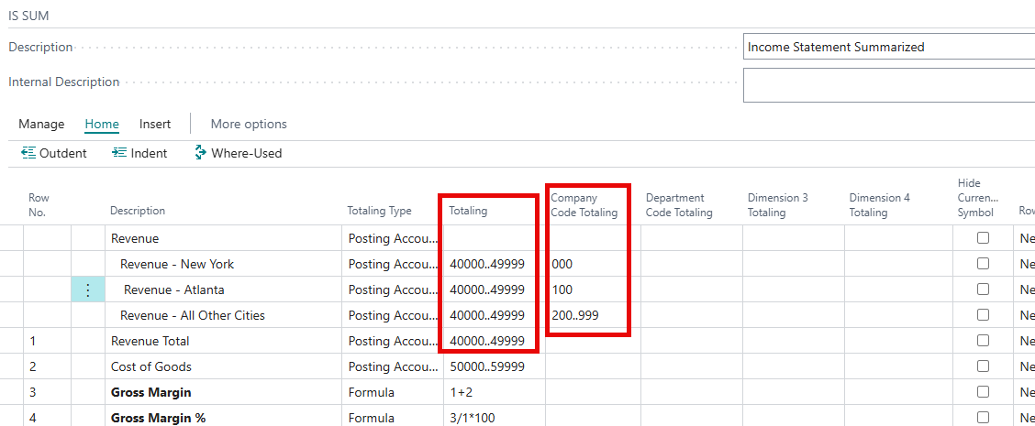
Dimensions in Row Definitions
Can total by up to four dimensions, this is where Analysis Views work magic!

Slide 9
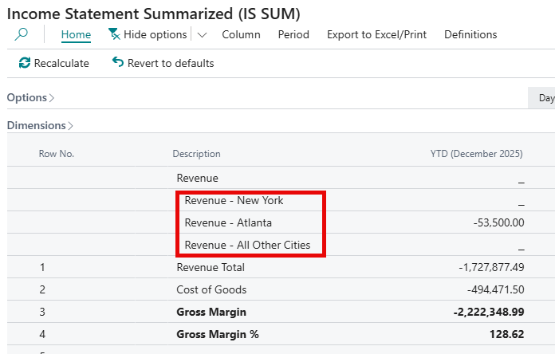
Dimensions in Row Definitions
Example report

Slide 10
Financial Reporting Dimensions in Column Definitions

Slide 11
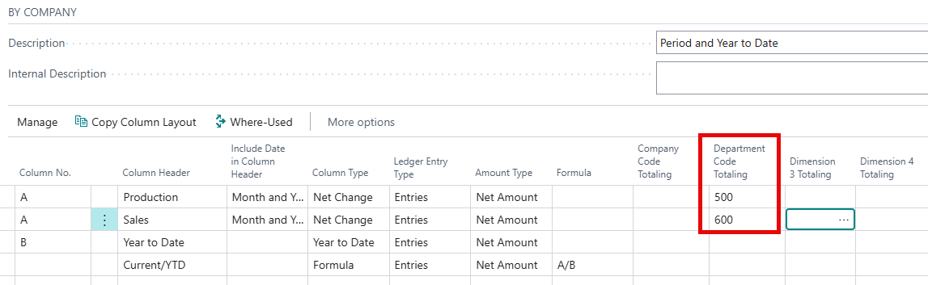
Dimensions in Column Definitions
Create Columns for the dimension values

Slide 12
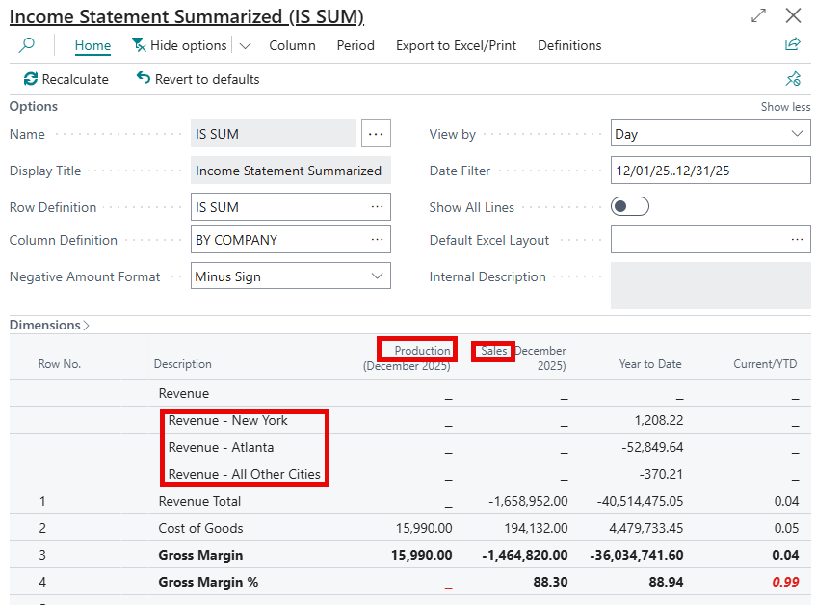
Dimensions in Column Definitions
Using Row and
Column Definitions with Dimensions

Slide 13
Next Steps – More videos to come
Financial Report Overview
Financial Report Template Building
Financial Report Template Usage

Slide 14

How Do I Watch the Episodes
https://www.youtube.com/@BC3Amigos
#FinancialReportingHero

