Slide 1




Financial Reporting Column Definitions – Part 2
Kim Dallefeld, MVP, MCT, MCP
#FinancialReportingHero

Slide 2

The BC 3 Amigos
https://www.youtube.com/@BC3Amigos

Slide 3
Session Overview
Extended Column Definitions
Examples
What’s next

Slide 4
What Can I Expect from this Session?
A deeper understanding of column definitions
Learn how to options in column definitions
See some of the features that are adjustable

Slide 5
Financial Reporting Column Definition Formats

Slide 6
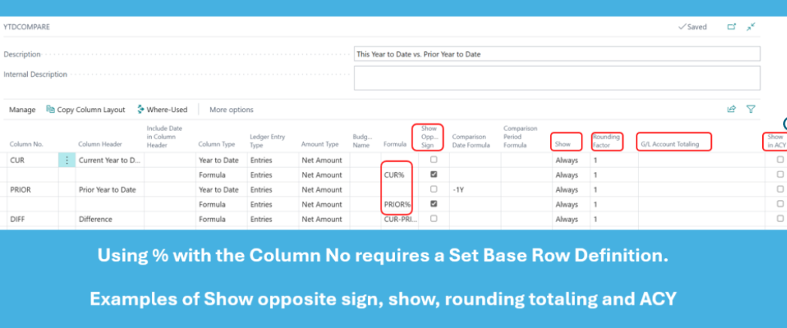
Column Definitions – Format Options

Slide 7
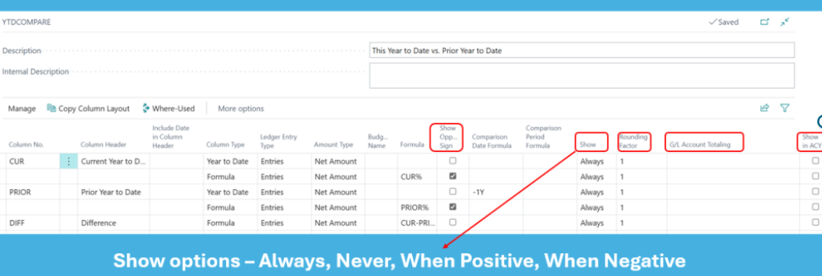
Column Definitions – Format Options

Slide 8
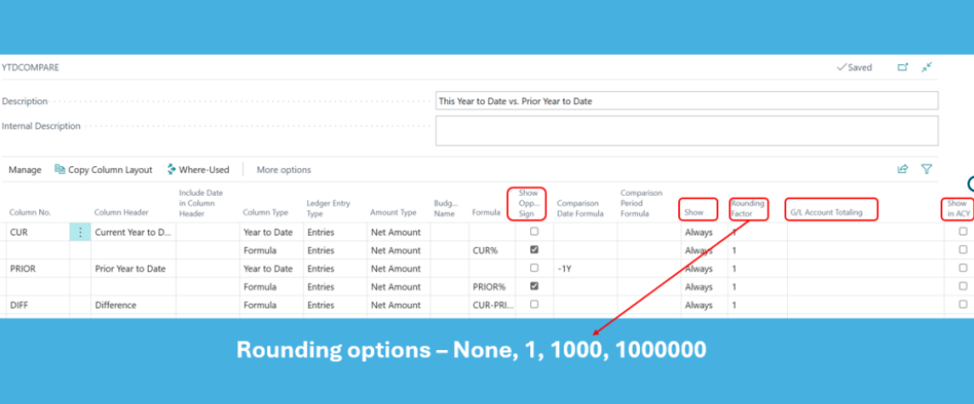
Column Definitions – Format Options

Slide 9
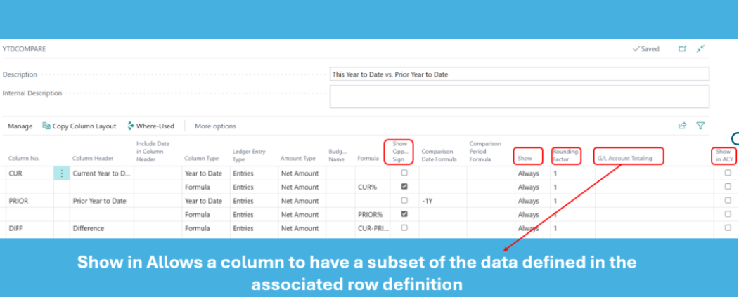
Column Definitions – Format Options

Slide 10
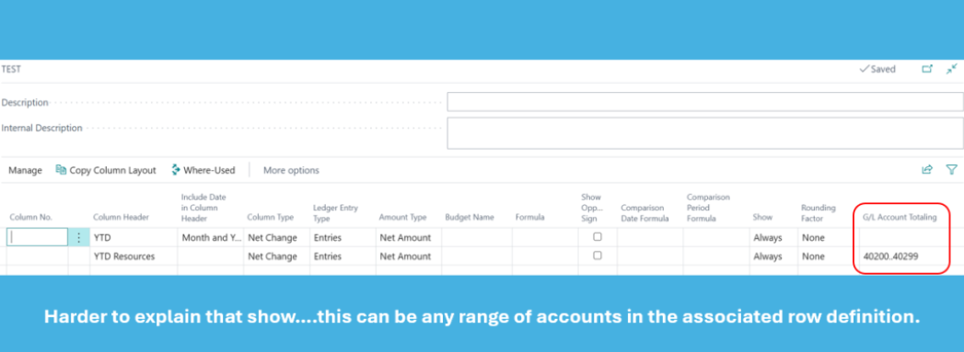
Column Definitions – GL Account Totaling

Slide 11
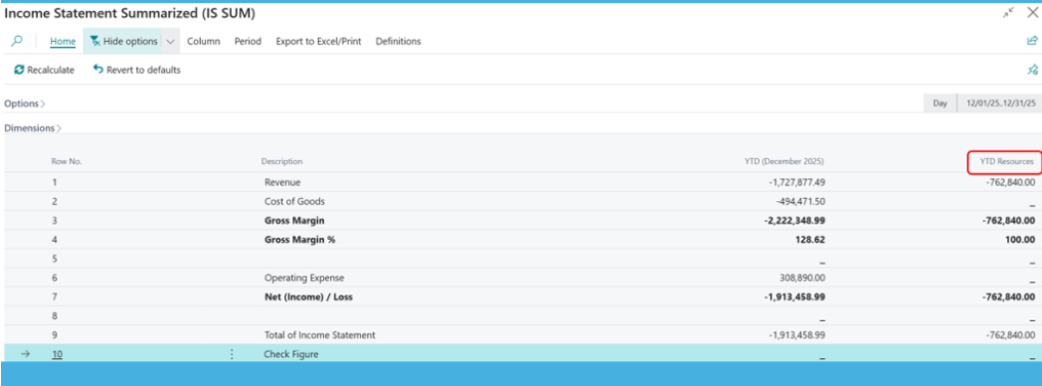
Column Definitions – GL Account Totaling

Slide 12
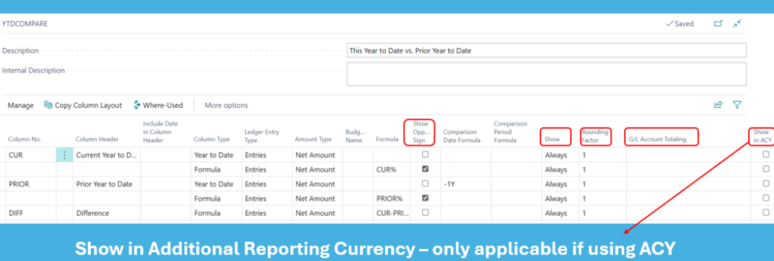
Column Definitions – Format Options

Slide 13
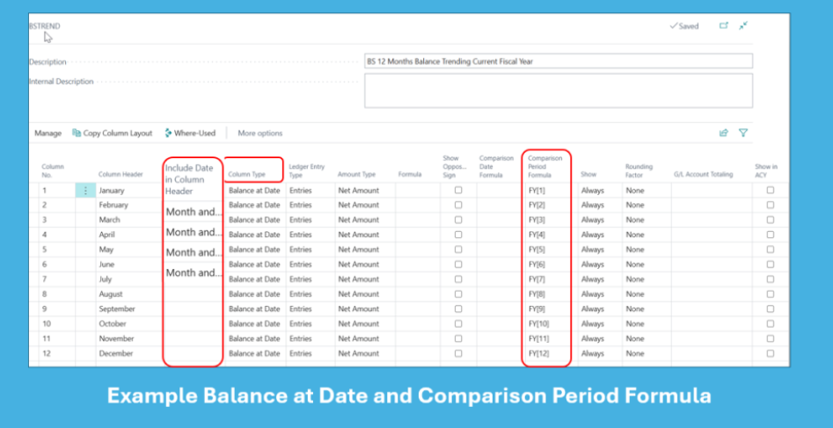
Column Definitions – Column Type, Periods

Slide 14
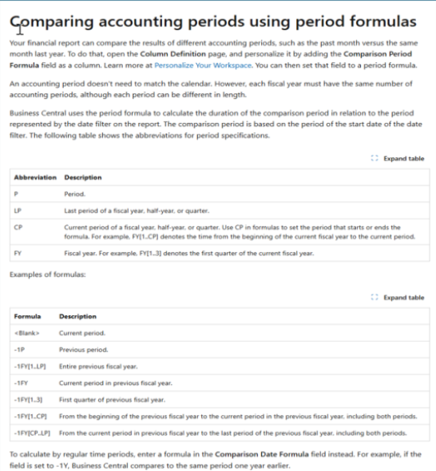
Column Definitions – Documentation
Great examples of how to use accounts periods and date formulas

Slide 15
Next Steps – More videos to come
Adding Dimensions
Financial Report Overview
Financial Report Template Building
Financial Report Template Usage

Slide 16

How Do I Watch the Episodes
https://www.youtube.com/@BC3Amigos
#FinancialReportingHero

